Slide 1
PROJECT OVERVIEW
Project-Healthcare Data Analysis – Financial Risk and Cost Evaluation
Description: Analyze healthcare utilization patterns, identify high-cost patients, evaluate financial risks, and visualize key trends.
Conducted By
Ediga Likhitha
Data Source- CSV datasets for patients, encounters, payers, procedures, organizations

Slide 2
TABLE OF CONTENT
Project Overview
Introduction
Objectives
Data Set
Tools
Data Manipulation Process
Insights
Recommended Analysis
Recommendations

Slide 3
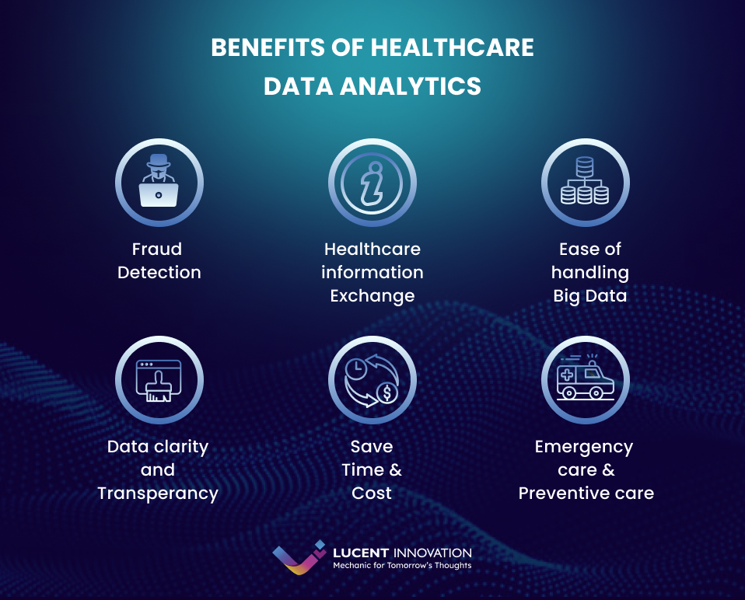
INTRODUCTION
Title: Healthcare Data Analysis – Financial Risk and Cost Evaluation
This project focuses on analyzing healthcare data to identify financial risk patterns, high-cost patients, and trends in procedure costs. It aims to help healthcare providers make informed decisions to optimize resource allocation and improve patient care efficiency.

Slide 4
OBJECTIVES
Analyze healthcare costs: Focus on base encounter costs and total claim costs.
Identify high-cost patients: Highlight those with repeated high-cost encounters.
Assess payer coverage: Understand how much each payer covers and what remains uncovered.
Explore procedure trends: Examine trends in procedure costs over time and correlate with diagnosis.
Geographical analysis: Visualize encounter distribution and cost variation by location.

Slide 5

DATA SET
Table/s Name
Patients
Procedures
Payers
Organizations
Encounters
No. Of Tables
5
Customers
Products
Categories
Dataset Structure:
Patients Encounters Procedures Payers Organizations
Rows- 832 Rows-27891 Rows-47701 Rows-9 Rows- 1 Columns-14 Columns-14 Columns-9 Columns-7 Columns- 8
shippers

Slide 6
TOOLS
SQL
Data extraction and manipulation.
Querying multiple datasets for metrics like encounter costs and high-cost patient identification.
TABLEAU
Data visualization and dynamic dashboards.
Visualizing encounter trends, geographical analysis, and patient insights.
MS PowerPoint
Presentation of project insights.
Communicating findings from SQL and Tableau with visual storytelling.
MS Power Query
Data cleaning and preparation
Transforming raw healthcare data into clean, structured datasets for analysis.
Power Pivot
Data modeling and relationships.
Linking tables (patients, encounters, payers) for comprehensive analysis.
DAX
Calculated columns and measures.
Creating measures to analyze costs, patient outcomes, and financial risks.

Slide 7
DATA MANIPULATION PROCESS
MEASURES AND CALCULATED COLUMNS
EXCLUSIONS AND FILTERS
Total Encounter Cost : Measure to sum up the total costs incurred for each patient encounter, including both Base Encounter Cost and Total Claim Cost.
DAX/SQL: Calculated as SUM(Base Encounter Cost) and SUM(Total Claim Cost).
Payer Contribution: A calculated column to show the percentage of costs covered by each payer.
Formula: (Payer Coverage / Total Claim Cost) * 100.
Uncovered Costs: Measure to calculate the remaining costs not covered by insurance or payers.
DAX/SQL: Total Claim Cost – Payer Coverage.
Average Encounter Cost: Measure to calculate the average cost per patient encounter.
Formula: AVG(Total Claim Cost).
Patient Encounter Count: A calculated column that tracks how many encounters each patient has had.
DAX/SQL: COUNT(Encounter ID) grouped by Patient ID.
Order Value (AOV
Excluding Non-Billed Encounters: Excluded rows where Total Claim Cost or Base Encounter Cost is zero or null to focus on billed healthcare services.
Filter: Total Claim Cost > 0.
Filtering Out Deceased Patients: Filtered out encounters where patients are marked as deceased (i.e., DeathDate is not null) to focus on current healthcare utilization.
Filter: DeathDate IS NULL.
Data Range Filtering: Applied a filter to focus only on encounters between July 2013 and April 2015 (project-specific requirement).
Filter: Start Date BETWEEN '2013-07-01' AND '2015-04-30’.
Removing Blank or Invalid Encounter Classes: Excluded rows where EncounterClass is blank or invalid to ensure accurate class-based analysis.
Filter: EncounterClass IS NOT NULL.
Excluding Outlier Costs: Removed extreme outlier costs (encounters with excessively high or low costs) to avoid skewing averages.
Filter: Applied based on Z-score or percentile-based outlier removal.’

Slide 8
INSIGHTS

Slide 9
KEY METRICS
Total Encounter Costs:
Represents the overall cost of healthcare encounters, including base encounter costs and total claim costs.
Helps in identifying high-cost encounters and patients who contribute to the majority of healthcare expenditures.
Payer Contribution Rate:
Calculates the percentage of each encounter cost that is covered by the payer.
Essential for understanding how much different payers (e.g., insurance companies) are contributing to patient healthcare costs.
Uncovered Costs:
Measures the portion of costs that are not covered by payers.
Helps in analyzing financial risk and the burden on patients due to out-of-pocket expenses.
Average Encounter Cost:
Provides insight into the average cost of healthcare services across all encounters.
Useful for comparing different organizations, encounter classes, or geographic regions.
High-Cost Patient Identification:
Metric used to identify patients with repeated high-cost encounters.
Helps in targeting interventions and improving healthcare cost management.
Encounter Count by Class:
Tracks the number of encounters per class (e.g., ambulatory, emergency, inpatient).
Helps to understand patient flow and the utilization of different healthcare services.
Encounter Duration:
The time span between the start and stop of each encounter.
Helps in analyzing healthcare service efficiency and the time patients spend in different types of encounters.

Slide 10
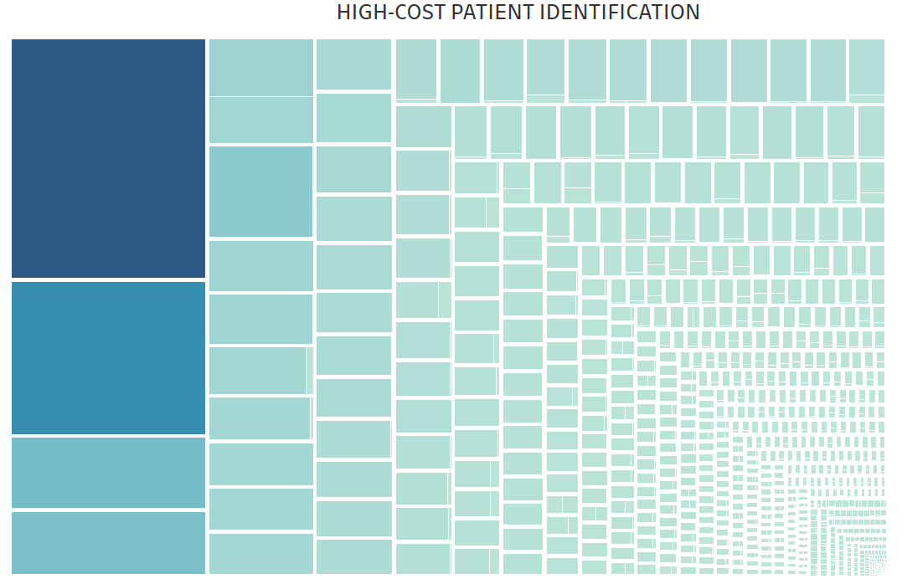
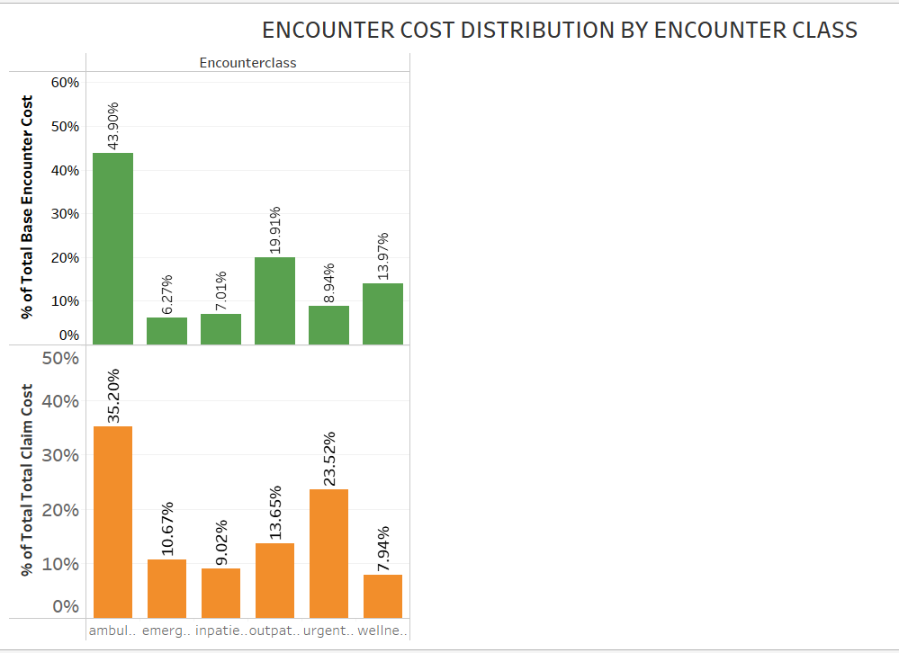
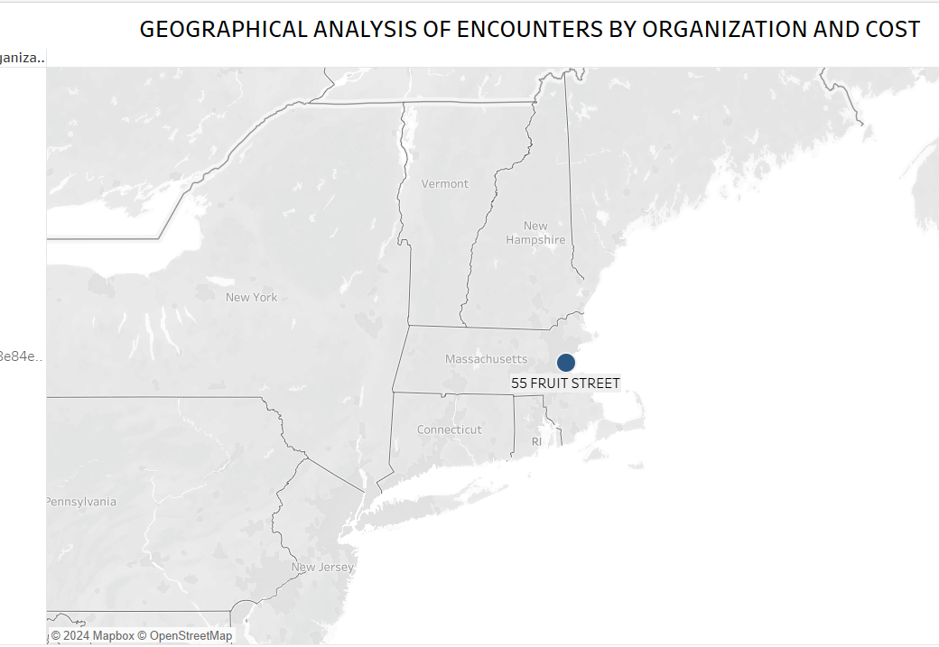
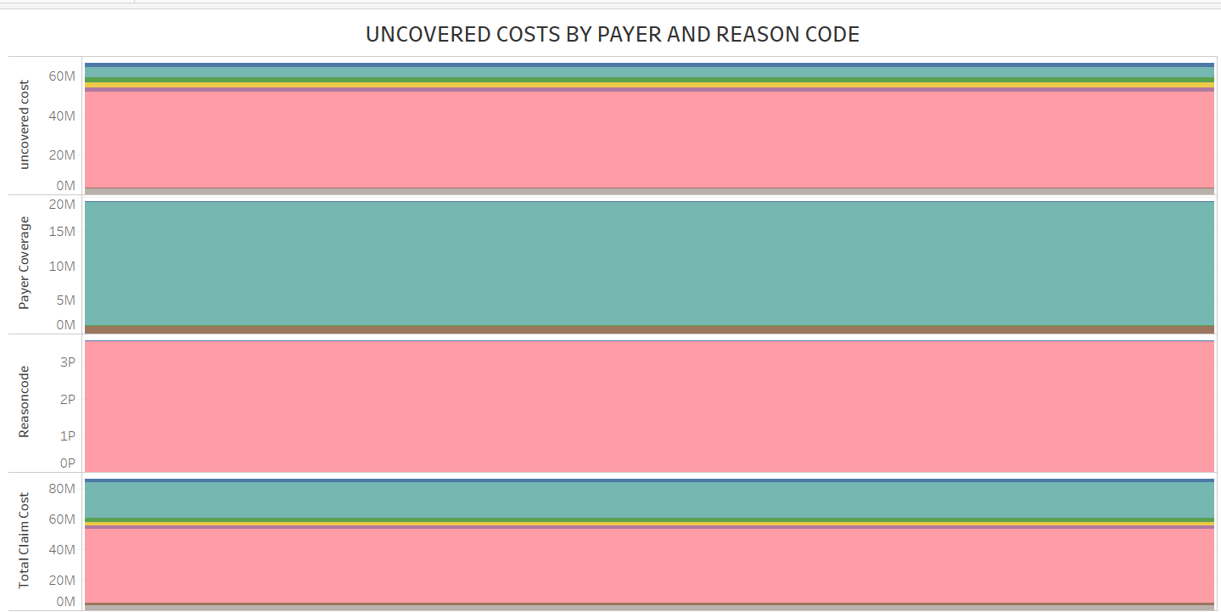
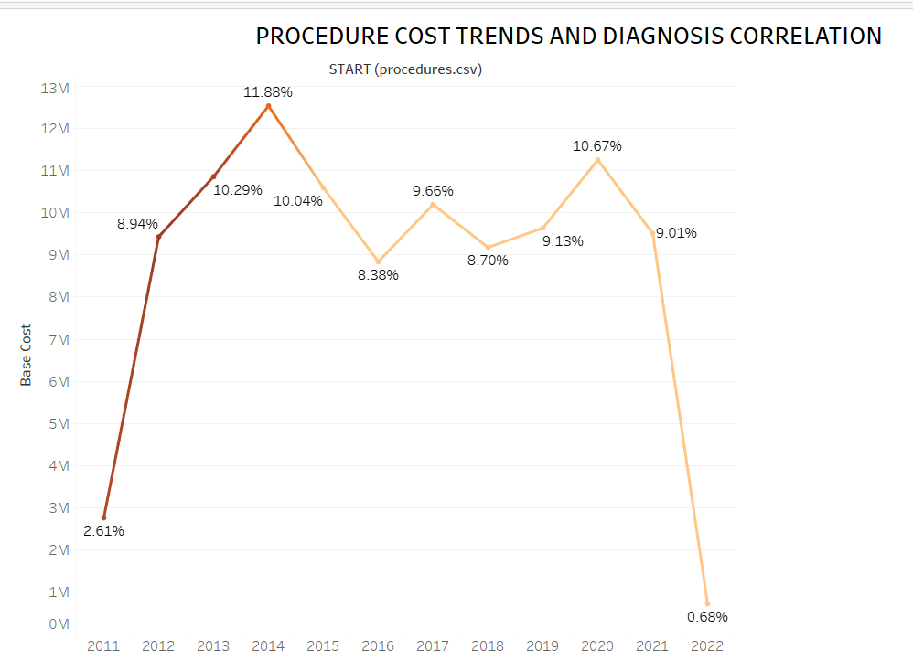
TABLEAU ANALYSIS

Slide 11
RECOMMENDED ANALYSIS
Predictive Modeling for Patient Risk:
Use machine learning models to predict high-cost patients based on their encounter history, demographics, and diagnosis codes.
This can help healthcare providers take preventive action and manage high-risk patients more effectively.
Procedure Cost Forecasting:
Perform trend analysis and forecasting on procedure costs to anticipate future healthcare costs.
This could help hospitals and insurers budget and plan for upcoming high-cost treatments.
Payer Contribution Efficiency Analysis:
Investigate which payers consistently provide the most coverage and which encounter types are least covered.
A deeper analysis can help hospitals and patients negotiate better terms with payers or select more beneficial plans.
Geospatial Healthcare Access Study:
Analyze how access to healthcare facilities impacts encounter costs, duration, and patient outcomes in different regions.
Identifying underserved areas could help improve healthcare infrastructure planning.
Patient Outcome vs. Cost Efficiency Analysis:
Correlate patient outcomes (recovery rates, readmission rates, etc.) with the cost of encounters.
This would allow healthcare organizations to understand if higher costs lead to better outcomes, and where efficiencies can be improved.

Slide 12
RECOMMENDATIONS
High-Cost Encounters: Inpatient encounters consistently have the highest average costs compared to other encounter types (ambulatory, emergency).
Uncovered Costs: Certain payers cover less than expected, leaving a significant portion of costs uncovered, especially for specific diagnosis codes.
High-Cost Patients: A small group of patients contributes disproportionately to overall healthcare costs, indicating a need for targeted intervention.
Procedure Costs: Rising trends in specific high-cost procedures, particularly those linked to chronic conditions or complex diagnoses.
Geographical Disparities: Regions with high patient traffic often show higher average encounter costs, indicating potential healthcare resource imbalances.

Slide 13
THANK YOU

